Slide 1
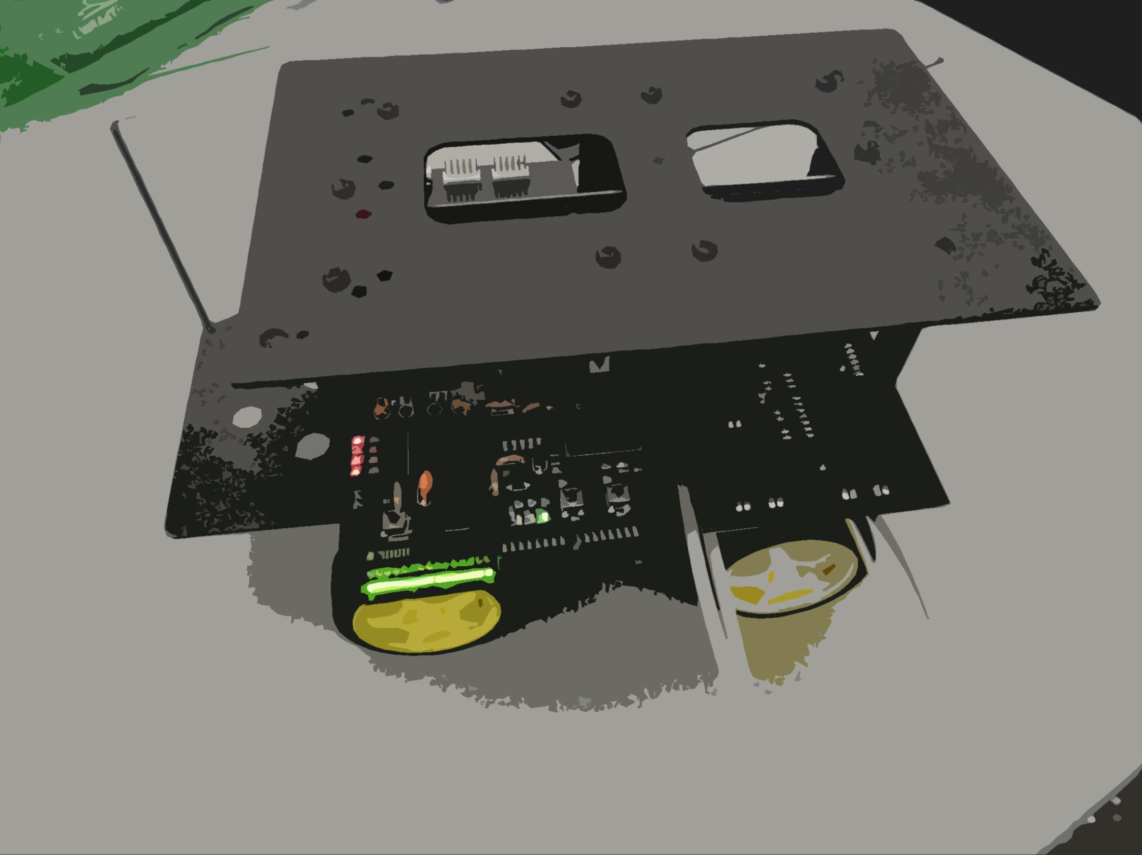
Autonomous
Robot Platform
ECE298 Paul Rayes
Hello.
I’m a robot.

Slide 2
Overall Goal
Overall Goal
to develop a platform that simplifies getting into robotics by supplying mobility and communications

Slide 3
Existing Solutions
Existing Solutions
Hobby robots: 3pi, Ardubot
  Not autonomous
  Often do not have communication
Commercial robots
  Cost thousands of dollars
Roomba
  No
The ideal solution does not exist

Slide 4
Overall Goals (partial list)
Overall Goals (partial list)
Cost under $500 (ideally under $300)
Easy to use
Navigates autonomously in an environment
Communicates wirelessly
Can have many robots working together
Can be used as a foundation for other projects
Divided goals into different versions

Slide 5
Version 1 Goals (partial list)
Version 1 Goals (partial list)
Reliable
Wireless communication
Detects and avoids obstacles
Creates a map of the environment
Goes to a point specified by the user
Basic base operational

Slide 6
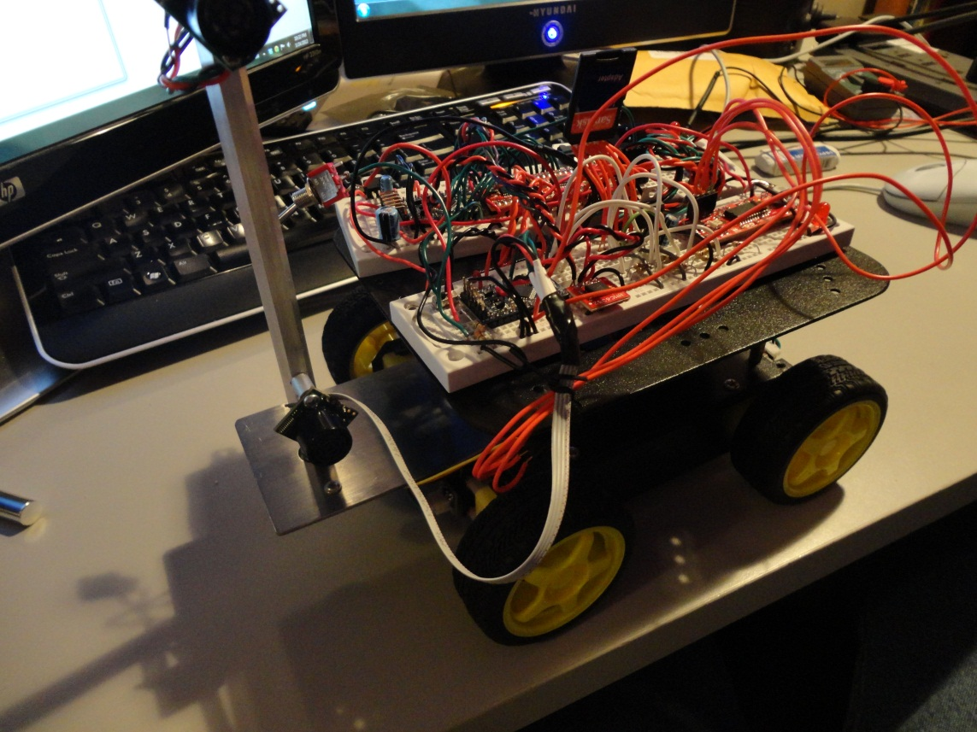
Last Semester
Last Semester
First prototype on breadboards
Basic obstacle avoidance
Too much time spent troubleshooting loose connections

Slide 7
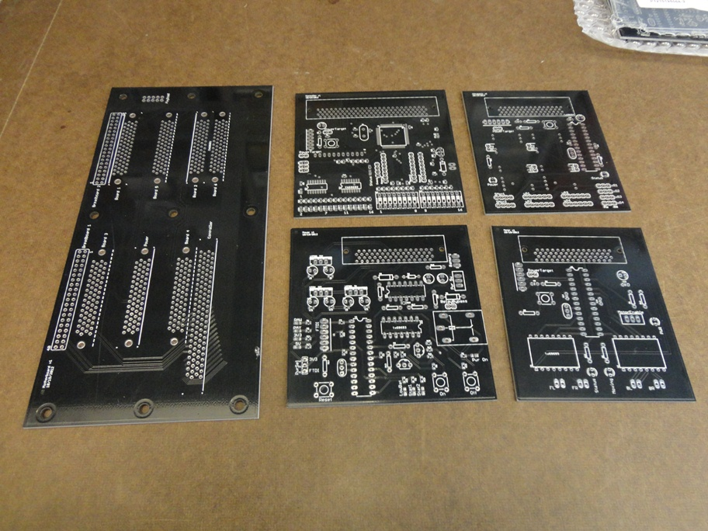
This Semester
This Semester

Slide 8
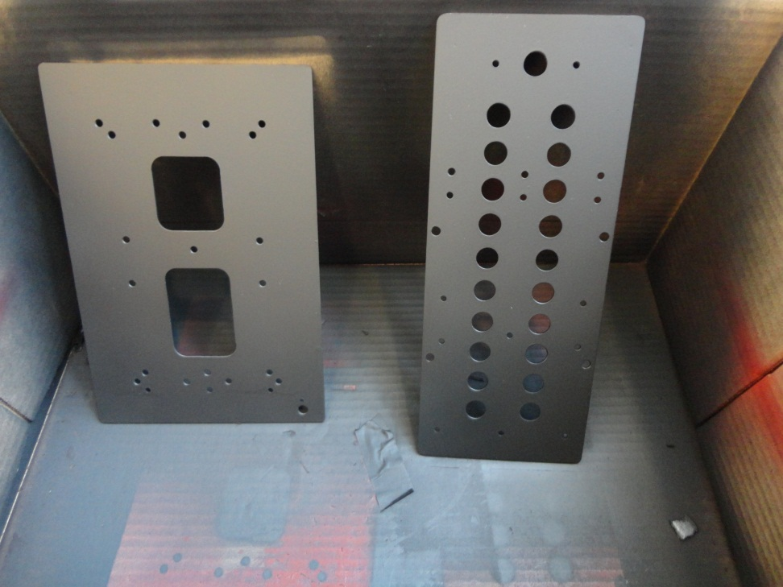
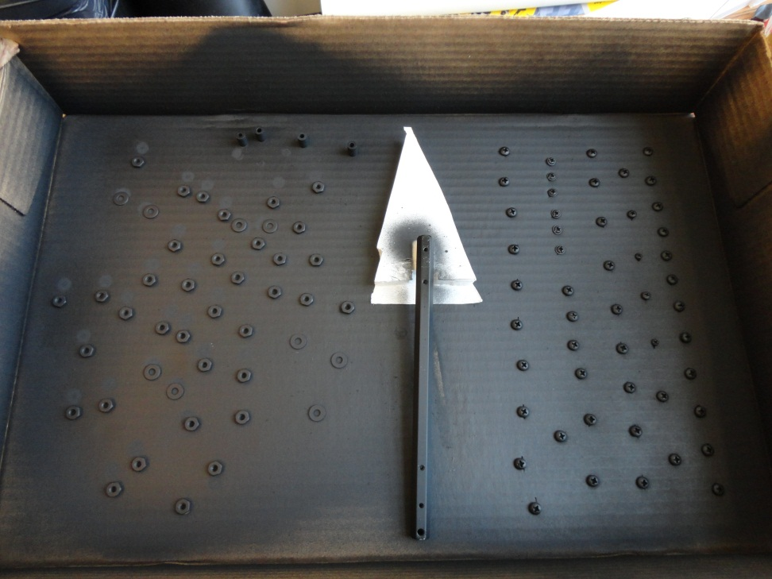
This Semester
This Semester

Slide 9
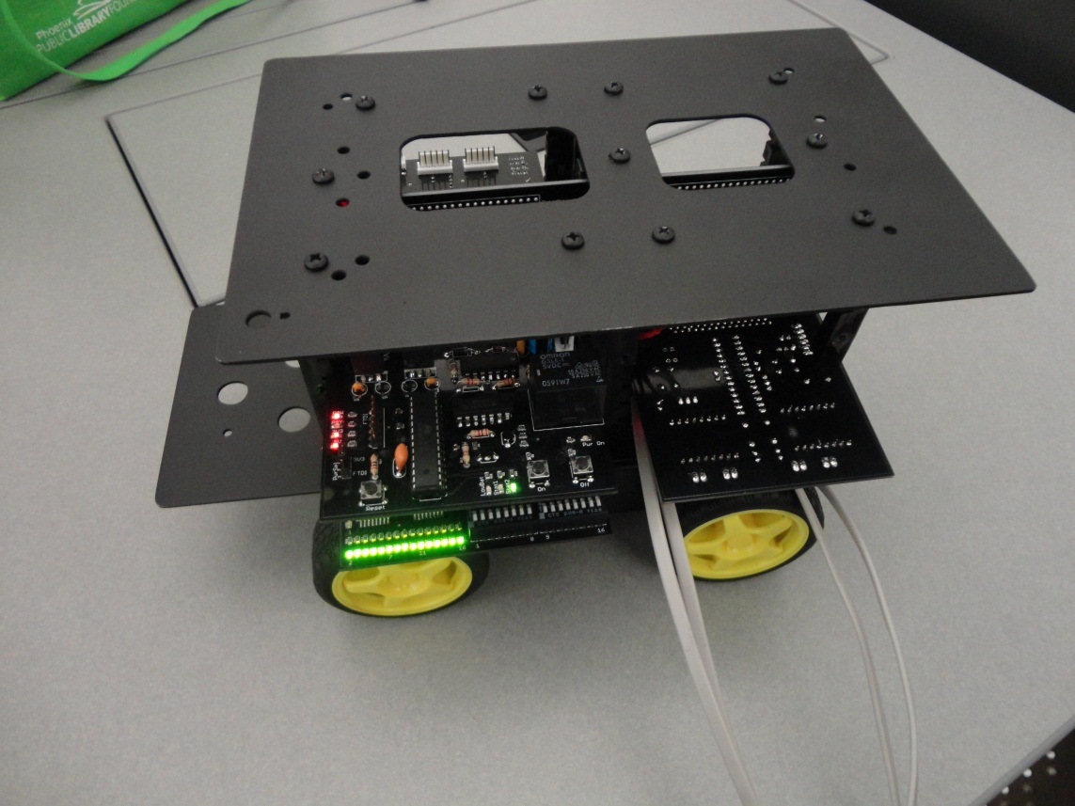
This Semester
This Semester
Need to write more code to control the new hardware

Slide 10
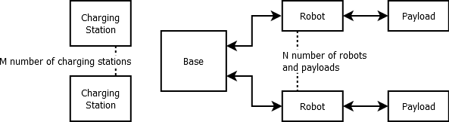
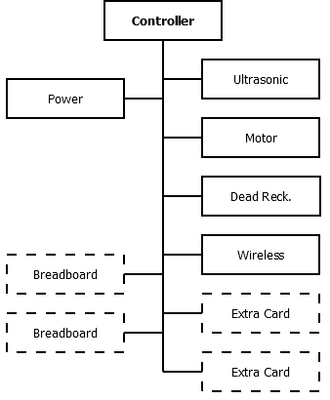
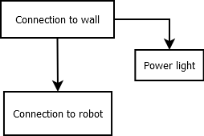
Block Diagrams
Entire System
(v2)
Robot
Charging
Station (v2)

Slide 11
Next Steps
Next Steps
Write the software
  Obstacle avoidance
  Map creation
  Navigation
Additional hardware
  Wireless
  Dead reckoning
Develop the base software

Slide 12
Failures / Lessons Learned
Failures / Lessons Learned
Two PCB connectors are 2mm off
Two circuit boards had problems in the layout
Fully check every design before building
Schedule twice as much time for everything as you expect you will need
Document as you go
Put connectors and buttons at accessible places

Slide 13
Questions?

